Slide 1
Instructional Rounds 1
Group Awesome
Percy Baras, Liz Levine, Estel Gomez, Daphne LaBua

Slide 2
Our Process
POP: Given the variety of ability levels of our students, how can we engage and support all learners in challenging tasks?
What is the challenging task?
What is the level of engagement of our students?
How has the teacher planned to support the variety of ability levels in the classroom?
Estel
We saw high engagement in the first classroom we visited
During our 1st debrief, we identified the cause of this to be group work
But we also uncovered that we tend to group students in ways that feel most comfortable to us...
So… what did we do?!

Slide 3
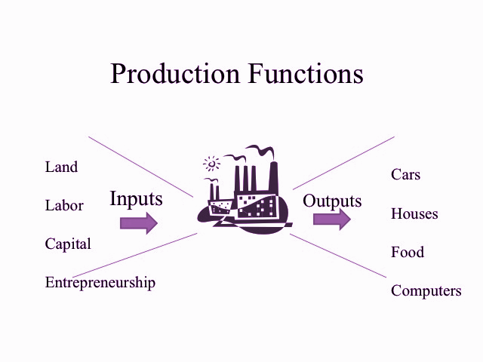
Inputs & Outputs
BEFORE:
  Students were divided into groups by behavior/ interests/ pre-unit test data
AFTER:
  Students were divided into groups based on different academic abilities (heterogeneous groups) using data sources like state exam scores, performance assessment scores, DRP results and unit exams

Slide 4
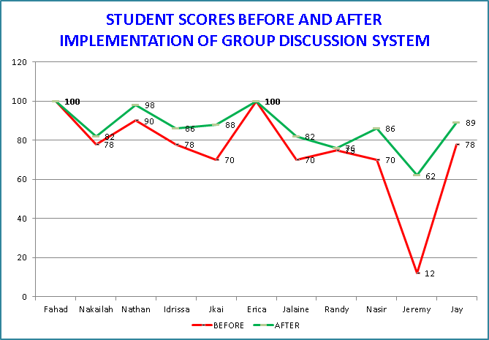
Successes in the Data
BEFORE Student scores were more dispersed and with a score range of 88 between high and low achievers.
AFTER Low achievers showed a significant increase in their performance

Slide 5
Successes in the Data
Conclusion Heterogeneous groups make the data more homogeneous.

Slide 6
Trends and Lingering Questions
Trends | Follow-Up POP
Students who performed better on assessments (“higher-level students”) were uncomfortable in heterogeneous groups Unclear responsibilities + Lack of Skill = Frustration | In situations where we notice the high level students uncomfortable with their roles in heterogeneous groupings, ... What kind of tasks and preparation lend themselves to heterogeneous or mixed-ability grouping?

Slide 7
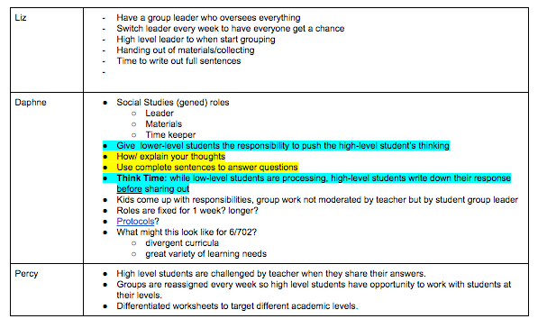
Next Steps: Adapting Best Practices
Heterogenous Group Roles (As observed in Percy’s 601 math) | How do we change this procedure to meet the needs of the all students in the group?
1 reader reads the problem (word problem) “round robin” to share opinion about how to solve the problem (facilitator prompts peers) group decides on the way to solve it and goes ahead with it spokesperson shares group’s findings with class

Slide 8
Strategies for Heterogeneous Grouping
Have clearly outlined group roles and responsibilities
  Switch defined roles [regularly] - leader, timer, materials, etc.
  Lower-level students the responsibility to push high-level student thinking
    Provide them with sentence-starters and questions they can ask
  Start with a high level student but OUTLINE the expectations for the role
    Create a simple checklist of responsibilities (like 3 UR rules)
    Responsibilities managed by students, facilitated by teacher
THINK TIME: teacher differentiates expectations for students
  Lower Level: time to process question
  Higher Level: write out full sentences of their responses
Teacher creates different tasks to target different levels
  What might this look like for 6/702?
  Use reading Protocols to dissect a complex text

