Slide 1
Collaborative Inquiry 6th grade ICT Humanities Class Co-teachers Daphne LaBua & Rachel Heslowitz @ The Urban Assembly Institute for New Technologies M410
Supported by Teacher Incentive Fund

Slide 2
Overview
In the course of three weeks, we partnered to engage in a student learning inquiry project in which we:
graded student work together
grouped students into quartiles
described and analyzed student work
selected content/skill of focus
implemented specific instructional strategy
observed student responses
described and analyzed second set of student work
noted areas of success and next steps

Slide 3
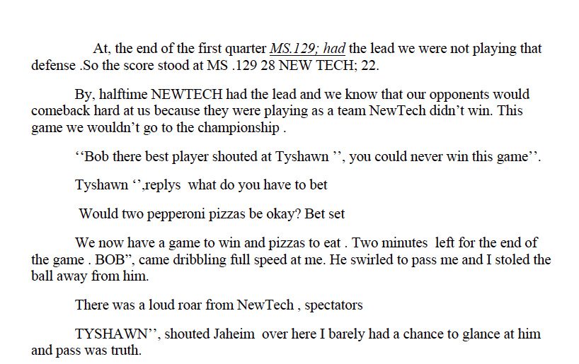
Describing & Analyzing Quartile 1
Common Errors & Misunderstandings:
Poor spelling
Syntax errors and incomplete sentences
Misuse or missing punctuation
Incoherent story line/ though processes
No paragraphing or poor paragraphing choices

Slide 4
Making Instructional Decisions Q1
Skill of Focus: Writing
Instructional Strategy: Annotation of the text to facilitate comprehension and use of sentence starters to facilitate completion of thoughts
Action Plan
Teachers will work with students in small “learning groups” to read and dissect a common informational text and respond to questions based on that text. Teachers will encourage students to mark up and annotate their texts to help them keep track of their thinking as they read. Teachers will provide students with sentence starters to support them in writing their responses.

Slide 5
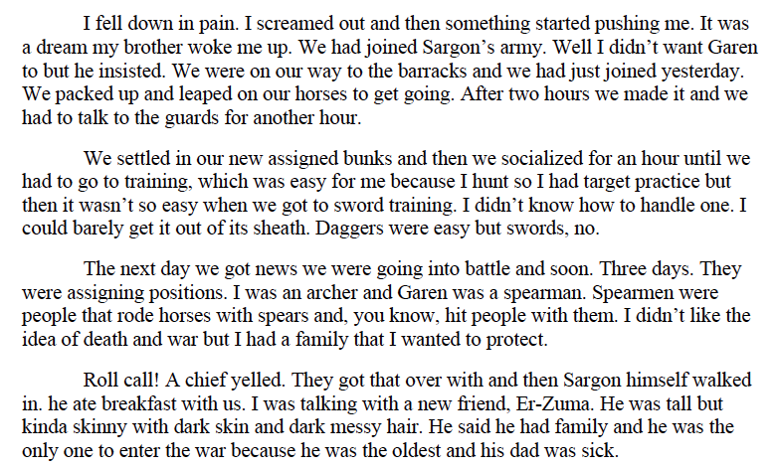
Describing & Analyzing Quartile 4
Common Errors & Misunderstandings:
Simple sentences
Repetitive vocabulary or incorrect use of new vocabulary
Misuse of punctuation marks
Incorrect verb tense

Slide 6
Making Instructional Decisions Q4
Skill of Focus: Writing
Instructional Strategy: Correct use of domain-specific vocabulary to enhance writing in complete sentences
Action Plan
Teachers will work with students in small “learning groups” to read and dissect a common informational text and respond to questions based on that text. Teachers will push students to write in complete sentences/ utterances that include domain-specific vocabulary learned from the reading in their written responses.

Slide 7
Implementing Instruction
Low-Inference Noticings
Q1 Instructional strategy:
Sentence starters for written responses & annotating the text to help remember information
Q1 students response to strategy:
Students began to write their responses once they heard the sentence starters; students marked up the text before answering and showed off their mark ups to the teacher
Q4 instructional strategy:
Writing more complex sentences & correct use of domain-specific vocabulary in written responses
Q4 student response to strategy:
Students pointed to new vocabulary words and worked on sounding them out; one student said that she would use a new word in her response

Slide 8
Debriefing Student Outcomes
Celebrations of success
Q1: Text annotation! (“2 pieces”) and complete sentences (“The author’s claim is that…”)
Q4: Writing complete sentences to express complex thoughts (“The author’s claim about the causes of conflict…”) using new vocabulary/ ideas (“deliberately”)
Areas still in need of growth
Q1: Correct use of commas
Q4: Inserting their own voice to prevent responses from sounding formulaic

Slide 9
Reflections
Positive Noticings | Challenges
This protocol kept our planning conversations evidence-based and solutions-oriented Student performance on (low-stakes) tasks was at the heart of our focused efforts Targeted intervention helped us feel successful when we noticed our strategies working and helped us to trouble-shoot and adjust more effectively when our strategies didn’t work | Protecting time to meet and reflect together each step of the way was a challenge and sometimes, our meetings felt rushed We were not able to apply the strategies to the same type of writing (strategies created using narrative stories, strategies applied on argumentative short answers) No two students responded the same way to our instructional strategies; this made it difficult for us to apply one strategy to one group and get consistent results

