Slide 1
The 2014 New Tech - Ramapo Partnership
Daphne Myrto LaBua
Bank Street Principal’s Institute
Wallace Fellow

Slide 2
Ramapo for Children
Notes:
Ramapo for Children is an organization that partners with NYC schools to help build teacher capacity to address the social emotional needs of challenging learners (those who have not traditionally experienced success inside our classrooms). Last year, our network, the Urban Assembly established a partnership with Ramapo and funded the opportunity to four of the middle schools in its network. This year, after some reflection and planning, the UA offered the opportunity to two of its middle schools. My school, M410, is one of those schools.

Slide 3
Internship Project
Our school needs to support its students in:
Establishing and maintaining positive relationships
Building their personal confidence
Helping them to make better behavioral choices in our classrooms
2013 Reflection
2014 Challenge: How do we need to change the program to meet our needs as a school?
Notes:
New Tech agreed to participate in this opportunity because it recognized that the mission of Ramapo was aligned to a recognizable need.

Slide 4
Thoughtful Planning: Addressing Our Needs
WHO?
19 boys
Grades 6-8
WHAT?
A clear(er) vision
WHY?
Social-emotional development
HOW?
Greater school-based support

Slide 5
Ramapo @ New Tech Program Components
School-Based Support
Weekly Meetings
Small Group Advisories
Peer mentorship
Weekly Facilitator’s Meetings
Ramapo Support
2 Weekend Leadership Retreats to Rhinebeck, NY
Ramapo coaching teachers

Slide 6
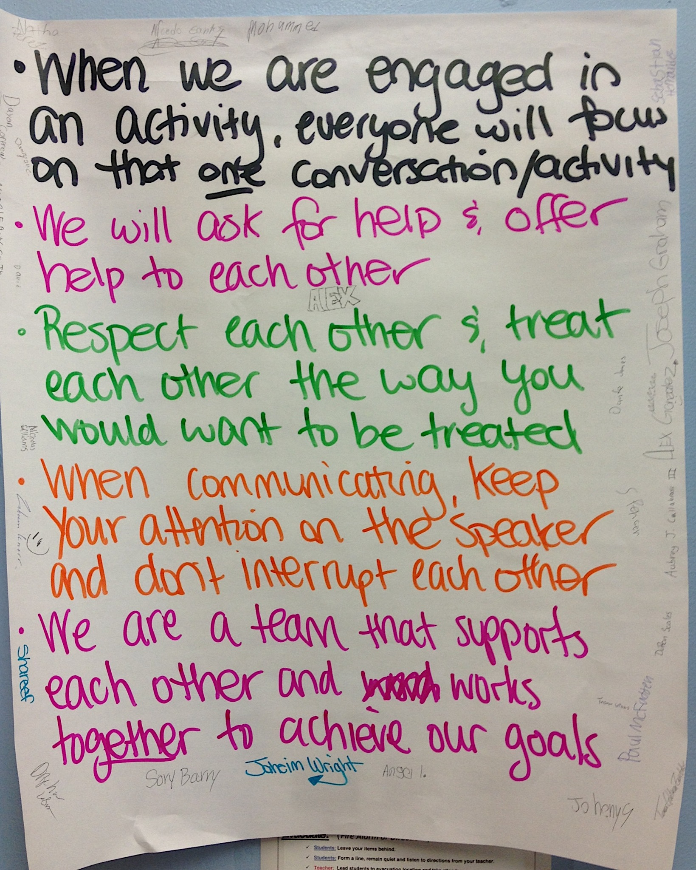
Ramapo @ New Tech Weekly Meetings & Retreats

Slide 7
March 2014 Reflection
Challenge
Resolution
No Shared Vision or Collective Ownership of Program among facilitators
Communication & consistency among the facilitators
Established Weekly Facilitator’s Meeting & protocol to share ideas and problem solve
Streamline communication

Slide 8
Ramapo @ New Tech Facilitators & Advisors

Slide 9
April 2014 Reflection
Challenge
Resolution
Communication with teachers about program
Supporting teachers in addressing persistently difficult classroom behaviors
Set up coaching schedule with our Ramapo coaches to shadow students, meet with teachers and share strategies

Slide 10
Next Steps
Group: Plan a Stepping Up Ceremony
School: Use Reflective Surveys to assess impact of the program
Students
Teachers
Administration
Partnership’s Future:
Meet with principal & Ramapo coach
Meet with UA Student Opportunities Coordinator & Ramapo administrators

Slide 11
Thank you for listening!!

