Slide 1
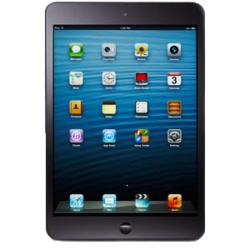
iPads @ New Tech
Daphne Myrto LaBua
LEAD 504 Fall 2013

Slide 2
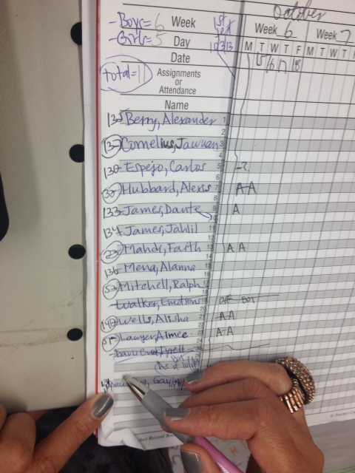
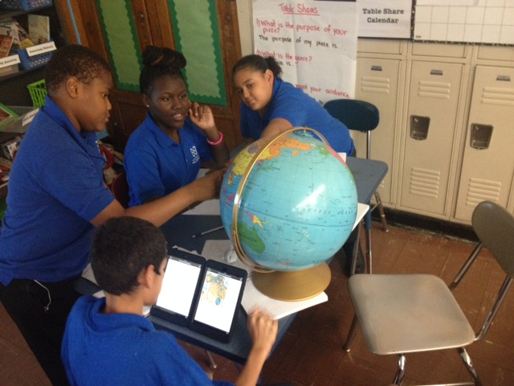
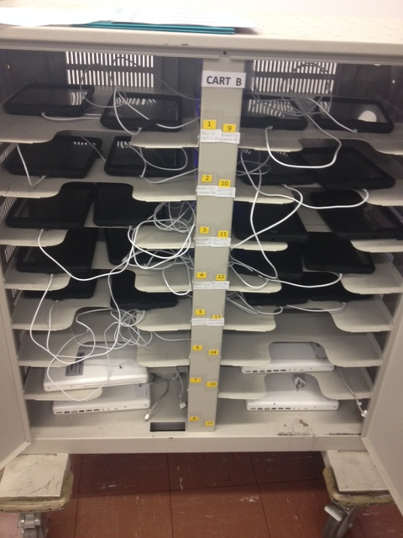
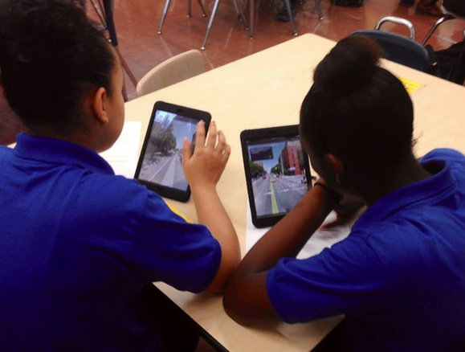
Overview
What’s in a name?
Technology
“New Technologies”
Show me the money!
Recruitment & enrollment
Maintaining a culture by protecting teachers
Redefining literacy
Success in the 21st century
September: getting ready
October: distribution
November: reflect and regroup
December: establishing a rhythm
Notes:
Distribute iPad minis (October 15, 2013)
Equipment release forms
Data Collection
Observe students
Interview teachers
Have informal conversations
Sharing strong practices
Challenge: Communication and Management
“Mini Management” Google Spreadsheet

Slide 3
iPad Mini Workshop

Slide 4
iPad Mini Workshop
Organize into these 3 content areas: Math, Science, Social Studies
Math: RI6.7
Social Studies: RI7.7
Science: RI8.7
Brainstorm
What does the specific standard that you are working with mean?
Once you are comfortable with what the standard means, what are some activities that students could engage with that simultaneously allow them access to the standard while integrating the iPads?

Slide 5
iPads @ New Tech
Daphne Myrto LaBua
LEAD 504 Fall 2013

Slide 6
Overview & Background
What’s in a name?
Technology
“New Technologies”
Show me the money!
Recruitment & enrollment
Maintaining a culture by protecting teachers
Redefining literacy
Success in the 21st century
The Urban Assembly Institute for
New Technologies

Slide 7
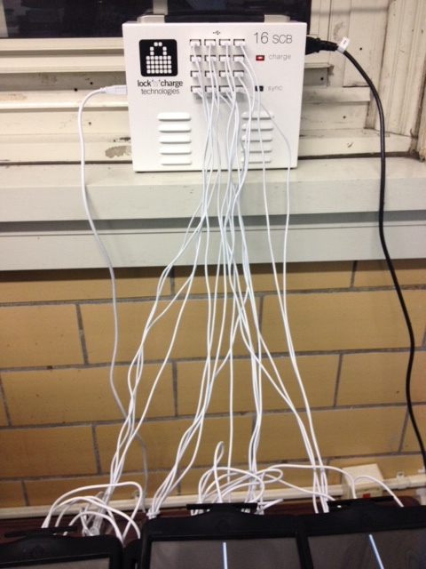
Process Phase I Preparation (September 2013)
Internet safety workshops
Inventory & beautification
Better late than never?
… @ Faculty/ Staff PD
Discussion of tentative structures
Distribution of teacher iPads
Notes:
Conduct internet safety workshops
Internet safety contracts
Inventory iPads and prepare them
Faculty and Staff PD (October 9, 2013)
Discussion of skeletal structure to support roll out
Distribution of teacher iPads (synced to look like student iPads)

Slide 8
Process Phase II Distribution (October 2013)
Distribute iPad minis
Data Collection
Observe students
Interview teachers
Informal conversations
Sharing strong practices
Challenge? Communication around Management!
Notes:
Distribute iPad minis (October 15, 2013)
Equipment release forms
Data Collection
Observe students
Interview teachers
Have informal conversations
Sharing strong practices
Challenge: Communication and Management
“Mini Management” Google Spreadsheet

Slide 9
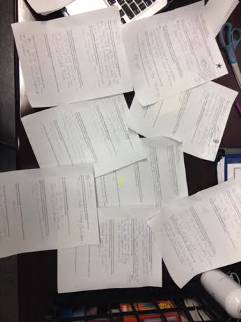
Process Phase III Hiatus & Reflection (November 2013)
iPads collected
Faculty and Staff PD
New Tech Tech Task Force (NT³F) established
Notes:
iPads collected from students to run updates and add apps (October 30, 2013)
Faculty and Staff PD:
Teacher survey and discussion to collect information about challenges, successes and suggestions for improvement

Slide 10
Process Phase III (NT³F)
Meetings
Goals
Deliverables
Ultimate Goal: engender teacher buy in
Distributed leadership, delegated responsibilities
Focus groups with distribution and collection teachers
Notes:
Members = UFT Chapter Leader + Science Teacher + Dean + Guidance Counselor
Meetings (November 1 & 15)
Goals: reflect upon and condense data & create monitoring system
Deliverables: concrete rules and consequences, tracking system, and next steps
Ultimate Goal: to engender teacher Buy In
Distributed leadership, delegated responsibilities
Focus group conducted with distribution and collection teachers

Slide 11
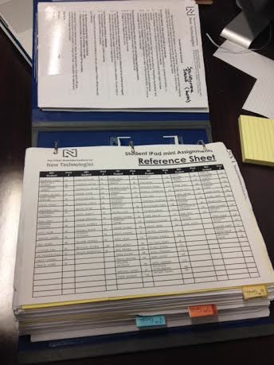
Process Phase IV Finding A Rhythm
Updated iPads redistributed
Management
Communication
Consistency
Addressing needs (ongoing)
Missing iPads
Teachers frustrated by colleagues
Teachers concerned with how to effectively use the resource
Notes:
Updated iPads redistributed (November 20, 2013)
Management
Organization & communication
Troubleshooting (ongoing)
Missing iPads
Swift response, scare tactics
Teachers frustrated by colleagues who don’t follow procedures
Mediation
Teachers concerned with how to effectively use the resource
Professional Development workshops

Slide 12
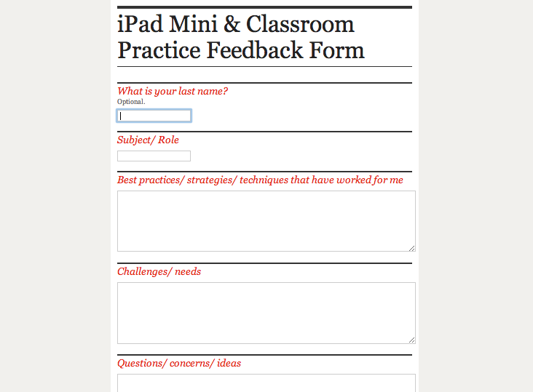
Assessment
Feedback during/ after ongoing professional development workshops
Ongoing NT³F meetings
Teacher feedback (Google form survey)
http://tinyurl.com/lqfuxow

Slide 13
Application of Learning
Applied Texts & Readings
Making Thinking Visible by R. Ritchhart, M. Church, K. Morrison
The Dangers and Opportunities of the Common Core by J. Brooks and M. Dietz
Qualitative Research
Classroom observations & low-inference note taking
Interviews
Focus Groups
Protocols used during professional development workshops and meetings to facilitate conversations and brainstorming
Open Space Technology
Wagon Wheels Brainstorm

Slide 14
Reflections
Successes:
Syncing and updating
Establishing the NT³F
Challenges:
Supporting the teachers in managing the iPads
Communication between teachers and the behavior support team to ensure that the consequences are carried out as indicated
Negotiating with my principal for the time to conduct workshops with teacher teams
Next Steps:
Creating a manual for teachers compiling our team’s best practices
Notes:
Successes:
Syncing and updating
Establishing the NT³F
Challenges:
Supporting the teachers in managing the iPads
Communication between teachers and the behavior support team to ensure that the consequences are carried out as indicated
Negotiating with my principal for the time to conduct workshops with teacher teams
Next Steps:
Creating a manual for teachers compiling our team’s best practices

